Slide 1


Denial of Service

Slide 2
Learning Objectives
Concepts and Terms
DoS/DDoS Attack Techniques
Botnet Network
DoS/DDoS Attack Tools
Detecting DoS/DDoS Attacks]
DoS/DDoS Countermeasures

Slide 3
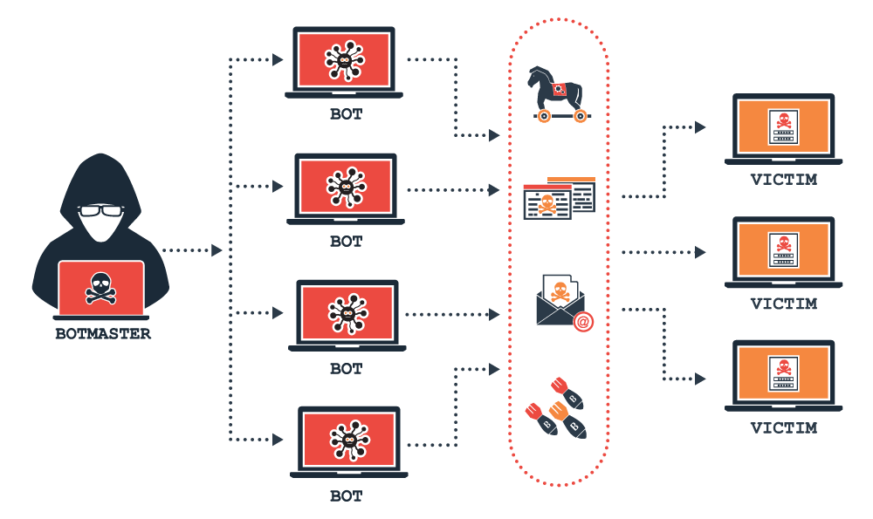

Slide 4
Denial-of-Service Attack
DOS is an attack on a computer or network that reduces, restricts or prevents accessibility of system resources to its legitimate users.
Attackers flood the system with non-legitimate requests or traffic to overload its resources.
Goal: Keep legitimate users away from using system
Target: Network bandwidth or connectivity

Slide 5
How to Tell if You are Experiencing a DoS Attack
The incapability to load certain websites
The extreme volume of spam emails
Uncharacteristically slow network performance, including extended load times for files or websites
Prolonged failure to access specific websites
A sudden loss of connectivity across devices on the same network

Slide 6
What Is the Most Common Form of DoS attacks?
Smurf Attack
SYN Flood
Ping of Death or ICMP Flood
Buffer Overflow Attacks
Teardrop Attack

Slide 7
Buffer Overflow Attacks
A buffer is a momentary storage location in the random access memory (RAM) utilized for holding data to facilitate its use by the CPU prior to writing it back to the disc.
Buffer has a size constraint and the aim of this type of attack is to overload it with more data than it can handle.
Buffer overflow attacks allow a cyber-attacker to overflow a network address with traffic so as to make it discarded or unusable.

Slide 8
Teardrop Attack
The malicious hacker distributes fragments of an IP address packet to a targeted network. In turn, the network tries to reassemble these fragments to its initial packets.
The method of assembling all these fragments to their initial packets wears out the system and as a result, it collapses.

Slide 9
Teardrop Attack
The system collapse or breakdown is due to the fact that the fields are created to obscure the system to the point where it is unable to assemble them together

Slide 10
How to Tell if You are Experiencing a DoS Attack
The incapability to load certain websites
The extreme volume of spam emails
Uncharacteristically slow network performance, including extended load times for files or websites
Prolonged failure to access specific websites
A sudden loss of connectivity across devices on the same network

Slide 11
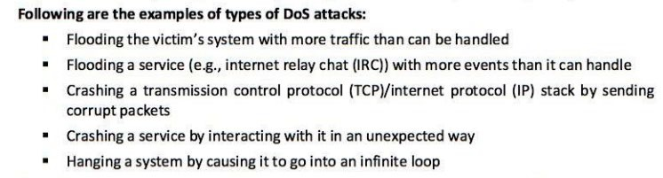
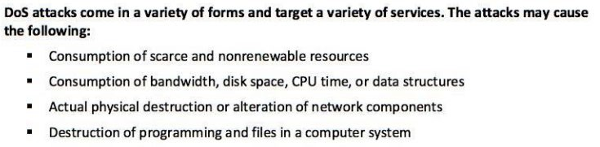
cont

Slide 12
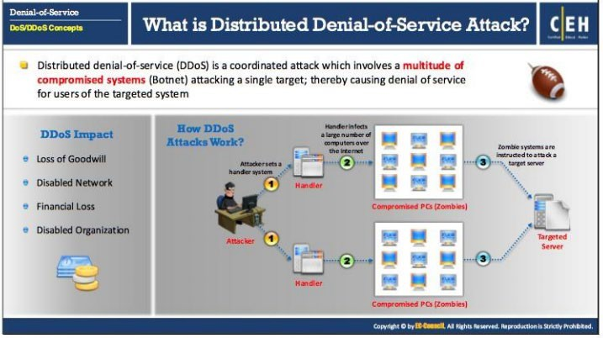
Distributed Denial of Service

Slide 13


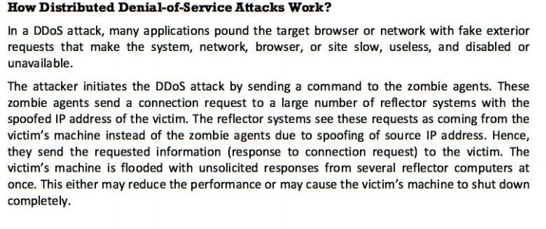
cont
Goal: First gain administrative access on as many systems as possible, upload DDoS software and run it on these systems simultaneously

Slide 14
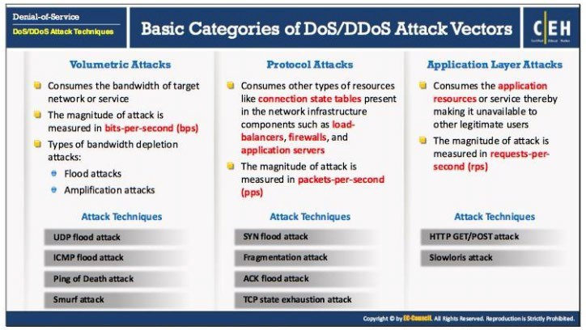
Dos/DDoS Attack Techniques

Slide 15
Volumetric Attacks
Exhaust bandwidth of target network/service, resulting in traffic blockage for legitimate users. Measured in bits per second(bps)
Target stateless protocols(have no built-in congestion avoidance)
2 types of bandwidth depletion attacks:
Flood attack – large volumes of traffic sent to target
Amplification attack – transfer messages to a broadcast IP address
Attack Techniques:
UDP flood attack
ICMP flood attack
Ping of death attack
Malformed IP packet flood attack
Spoofed IP packet flood attack
Smurf Attack

Slide 16
Smurf Attack
Here, the perpetrator exploits the broadcast address of a weak network by distributing spoofed packets that belong to the aimed device.
Once the receivers of these spoofed packets respond, their Internet Protocol (IP) address is then flooded with those responses.

Slide 17
Smurf Attack Cont’
Considering the fact that a particular Internet Broadcast Address can sustain at most 255 hosts, a smurf attack works by intensifying each ping by 255.
The outcome is that the network becomes slow to a level where it becomes difficult to use and discarded

Slide 18
Ping of Death or ICMP Flood
ICMP flood attack is utilized to take misconfigured or unconfigured network and implement them in distributing spoof packets to ping all the system within that network.
The ping of death attack is often merged together with ICMP flood.

Slide 19
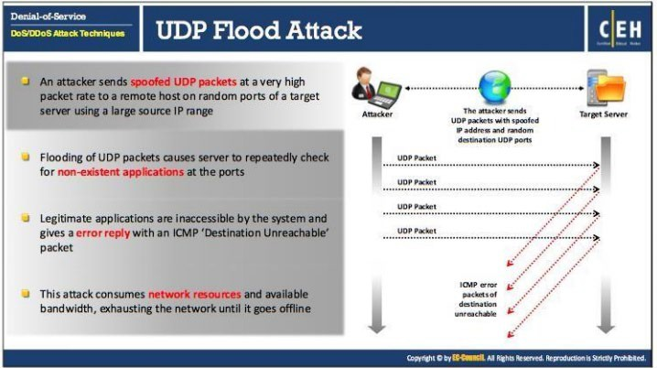
Attack Techniques

Slide 20
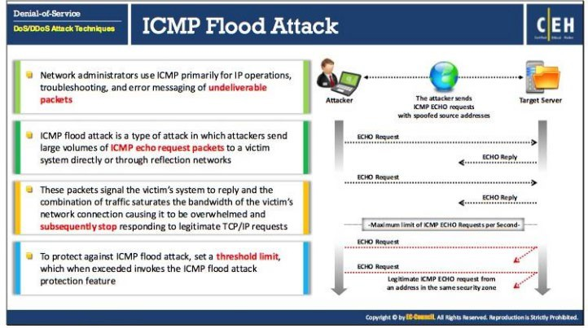
ICMP Attack

Slide 21
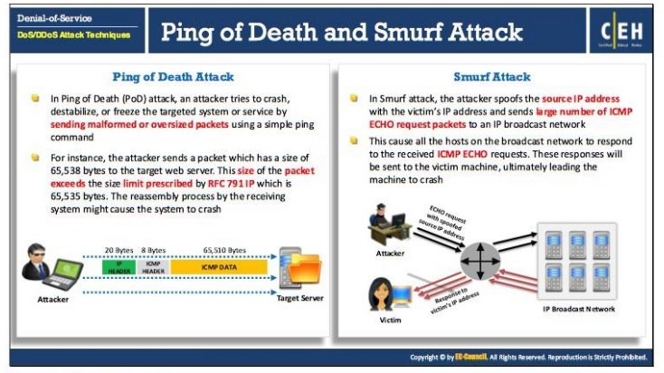
Ping of Death/Smurf Attack

Slide 22
Protocol Attacks
Exhausts resources available to the target.
These attacks consume the connection state tables in network infrastructure(i.e. load balancers, firewalls, app server) and no new connections will be allowed.
Magnitude of attack measured in packets per second(pbs) or connections per second(cps)
Attack techniques
SYN flood attack
RST attack
Fragmentation attack
ACK flood attack
TCP connection flood attack
TCP state exhaustion attack

Slide 23
SYN Flood
SYN Flood attacks occur when a cyber-attacker sends a request to connect to a server but does not complete the connection known as the three-way-handshake.
This type of connection is a technique utilized in a Transmission Control Protocol (TCP)/IP network to form a connection between the server and local host/client.

Slide 24
SYN Flood Cont’
The outcome of the uncompleted handshake is that the network becomes overwhelmed with connection requests, making the connected port inaccessible to others.
The malicious hacker will keep on sending requests, flooding all available ports until the authorized users are unable to connect.

Slide 25
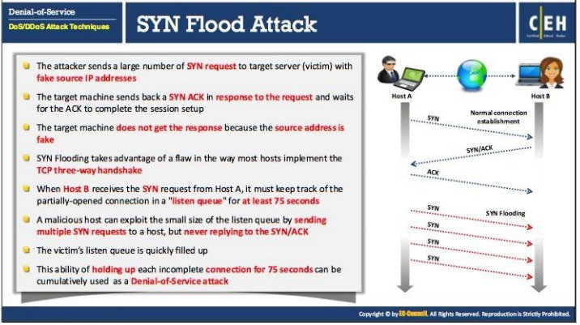
SYN Flood Attack

Slide 26
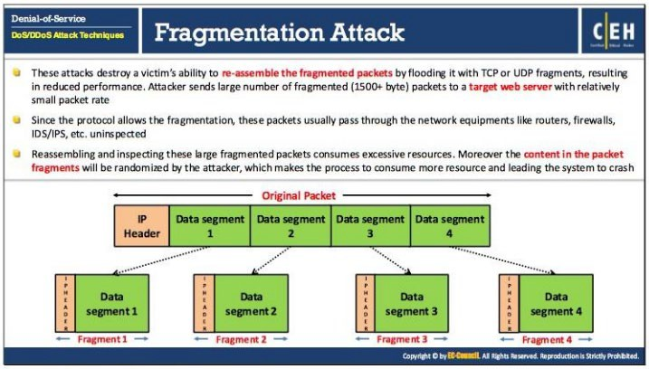
Fragmentation Attack

Slide 27
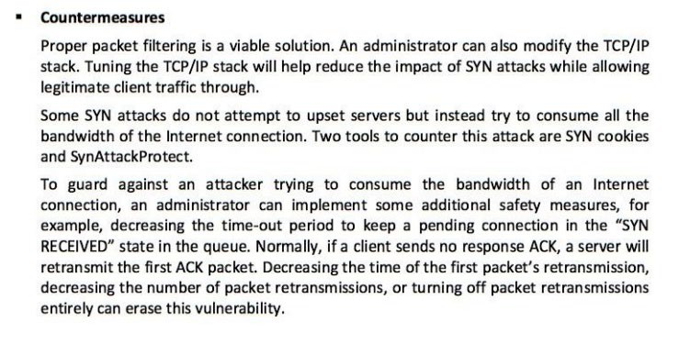
Protocol Attack Countermeasures

Slide 28
Application Layer Attacks
Attacker tries to exploit vulnerabilities in application layer protocol or in application itself to prevent access to legitimate users.
Resources consumed by opening up connections and leaving them open until now new connections can be made.
Magnitude of the attack is measured in requests per second(rps)
Rely on software related exploits such as buffer overflows.
Attack techniques:
HTTP flood attack
Slowloris Attack

Slide 29
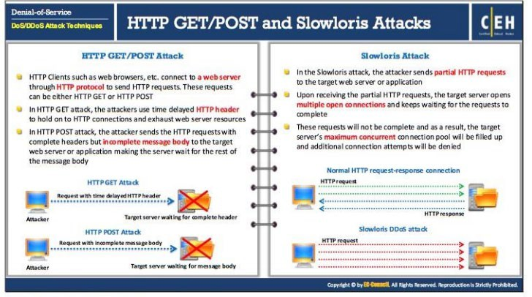
HTTP GET/POST and Slowloris Attacks

Slide 30
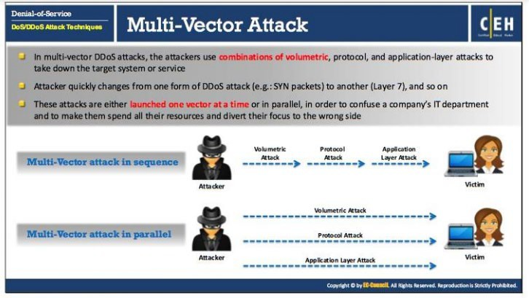
Multi-Vector Attack

Slide 31
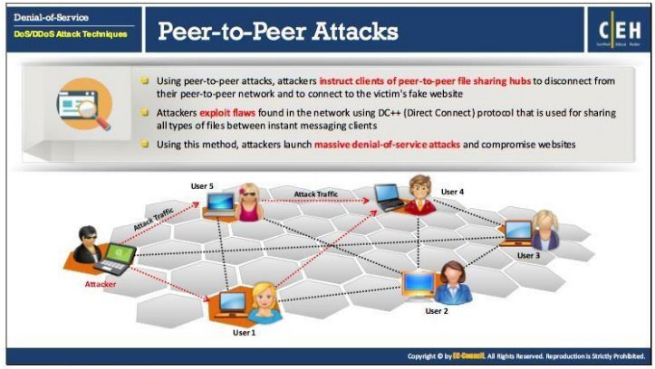
Peer-to-Peer Attacks

Slide 32
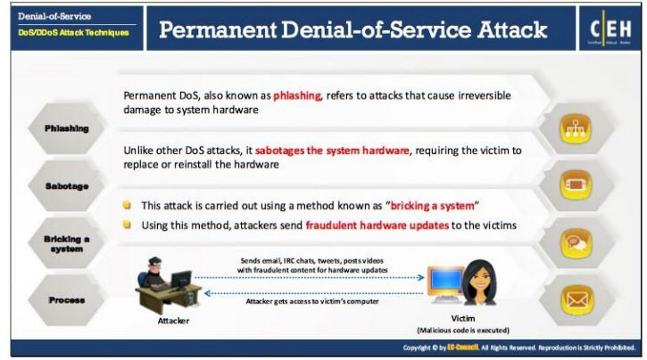
Permanent Denial of Service Attack

Slide 33
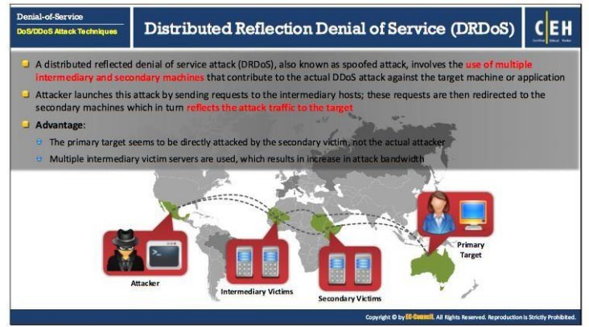
Distributed Reflection DoS

Slide 34
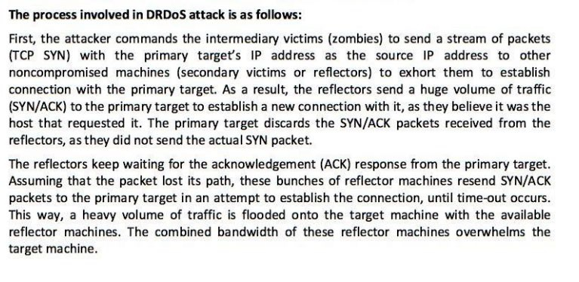
cont

Slide 35
Botnet
Bots are software applications that run automated tasks over the internet
A botnet is a network of computers infected with malicious software and controlled as a group without the owner’s knowledge.
Botnets can be used for:
DDoS attacks
Sniffing traffic
Google AdSense abuse
Mass identity theft
Spamming
Keylogging
Spread new malware
-Manipulate online polls/games

Slide 36
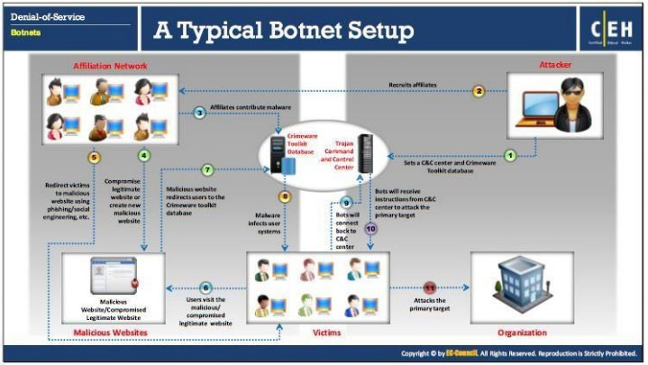
Botnet cont

Slide 37
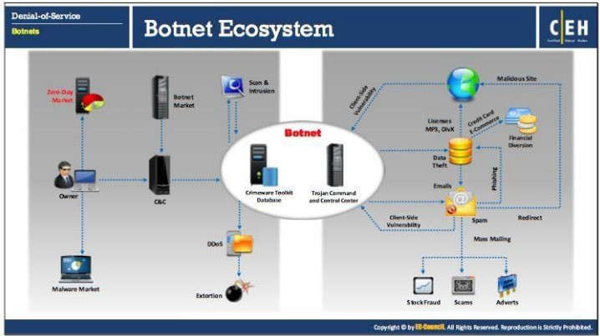
Botnet cont

Slide 38
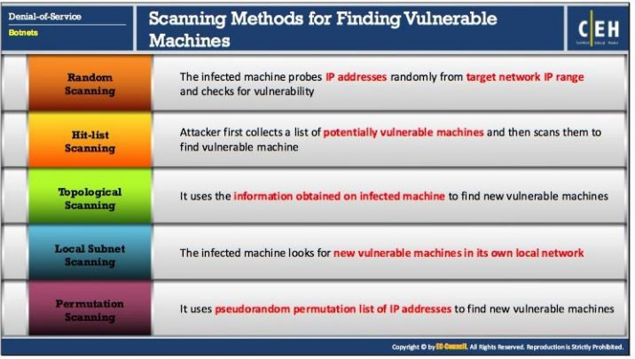
Scanning Methods

Slide 39
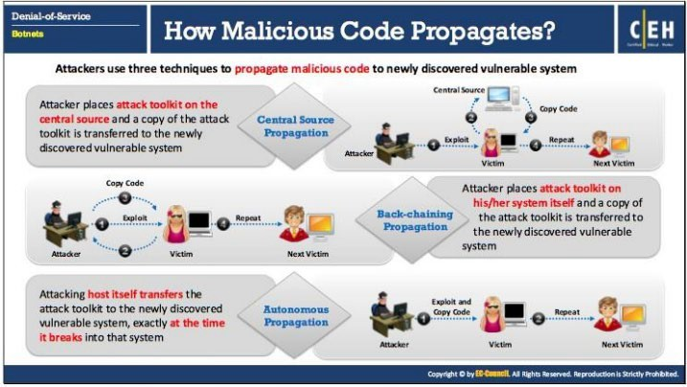
Malicious Code Propagation

Slide 40
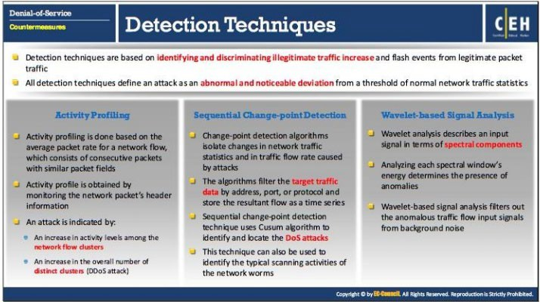
DoS/DDoS Detection

Slide 41
DoS/DDoS Countermeasure Strategies
Absorbing the attack – Use additional capacity to absorb(spread out) attack. Requires additional resources. Cost disadvantage.
Degrading Services – Identifying critical services and cutting down on non-critical services. To keep critical services functional.
Shutting down the services – Until an attack ceases.

Slide 42
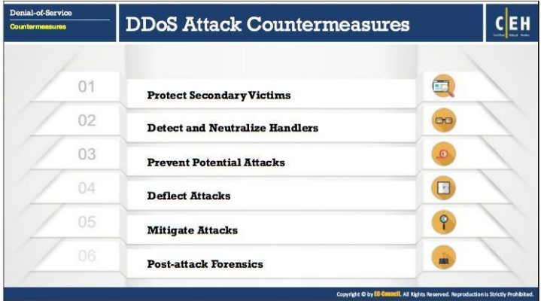
DDoS Countermeasures

Slide 43
DDoS Countermeasures cont
Protect Secondary Victims
Individual Users – Antiviruses, Increased awareness, disable unnecessary services
Network Service Providers – dynamic pricing for network usage
•
Detect and Neutralize Handlers
Network traffic analysis
Neutralizing botnet handlers(renders some agents useless)
Identifying spoofed source address
Prevent Potential Attacks
Egress filtering
Ingress filtering
TCP intercept
Rate limiting

Slide 44
DDoS Countermeasures cont
Deflect Attacks – Using honeypots
Mitigate Attacks
Load balancing
Throttling
Drop requests
Post attack forensics
Traffic pattern analysis
Run zombie zapper tool
Packet traceback
Event log analysis

Slide 45
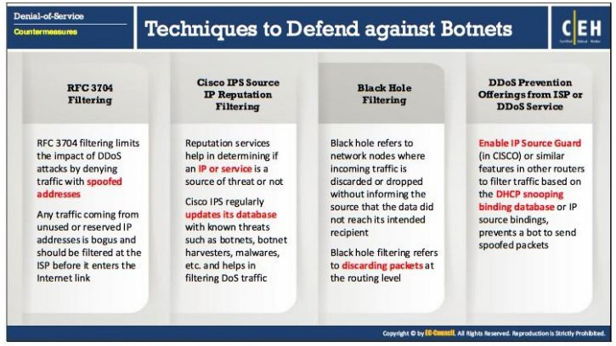
Defending against botnets

Slide 46


Thank you!
Any Questions?

Slide 47
LAB MANUALS
Kindly follow the link below to get a pdf of the denial of service lab manuals
http://jite.org/documents/Vol12/JITEv12IIPp299-319Trabelsi1193.pdf

